Slide 1


Pemrograman Framework
Minggu 05 Pengenalan Controller & View di Laravel
Dipresentasikan Oleh:
Purnama Anaking, S.Kom., M.Kom.
Controller
View

Slide 2
Kemampuan Akhir yang Direncanakan:
Mahasiswa mampu menerapkan penggunaan Controller, View dan Form pada framework Laravel.

Slide 3
Outline
Pengenalan Controller
Pengenalan View
CSRF (Cross Site Request Forgery)
Form Validation

Slide 4
Pengenalan Controller

Slide 5
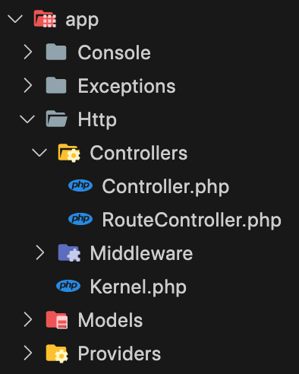
Pemrograman Framework
Overview
Instead of defining all of your request handling logic as Closures in route files, you may wish to organize this behavior using Controller classes.
Controllers can group related request handling logic into a single class.
Controllers are stored in the app/Http/Controllers directory.

Slide 6
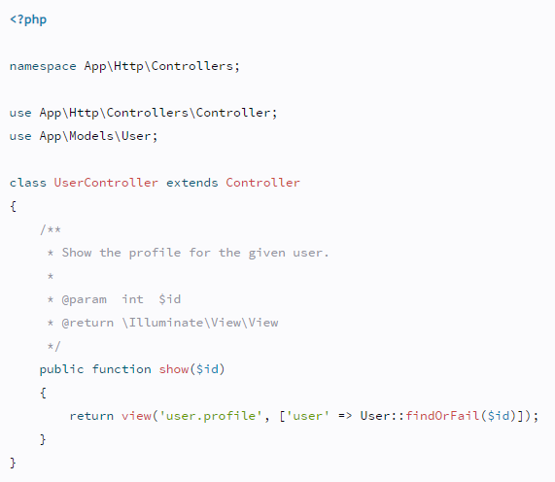
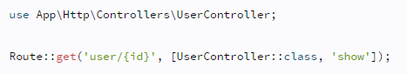
Pemrograman Framework
Basic Controllers (Defining Controllers)
Below is an example of a basic controller class. Note that the controller extends the base controller class included with Laravel.
You can define a route to this controller action like so,

Slide 7

LIVE CODING SESSION
Let’s Code!

Slide 8
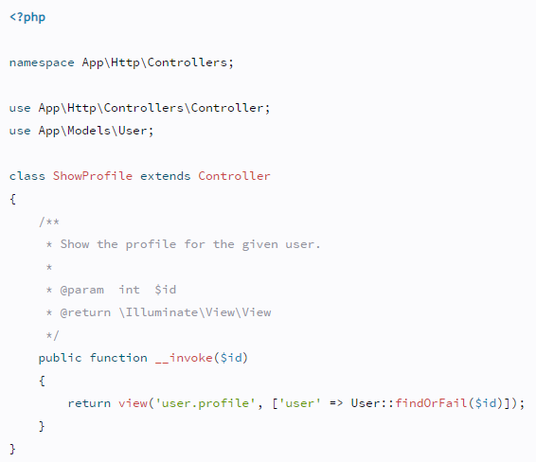
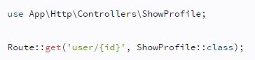
Pemrograman Framework
Basic Controllers (Single Action Controllers)
If you would like to define a controller that only handles a single action, you may place a single __invoke method on the controller.
When registering routes for single action controllers, you do not need to specify a method.
You may generate an invokable controller by using the --invokable option of the make:controller Artisan command.

Slide 9
LIVE CODING SESSION
Let’s Code!

Slide 10
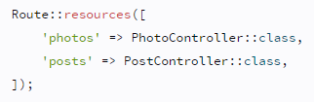
Pemrograman Framework
Resource Controllers
Laravel resource routing assigns the typical "CRUD" routes to a controller with a single line of code. For example, you may wish to create a controller that handles all HTTP requests for "photos" stored by your application. Using the make:controller Artisan command, we can quickly create such a controller.
This command will generate a controller at app/Http/Controllers/PhotoController.php. The controller will contain a method for each of the available resource operations.
Next, you may register a resourceful route to the controller.
You may register many resource controllers at once by passing an array to the resources method.

Slide 11
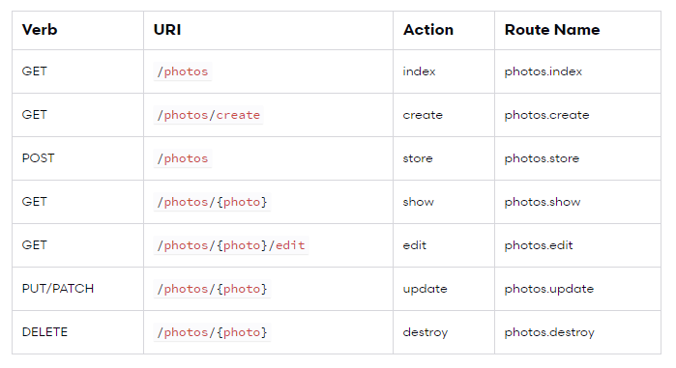
Pemrograman Framework
Resource Controllers
Actions Handled By Resource Controller
If you are using route model binding and would like the resource controller's methods to type-hint a model instance, you may use the --model option when generating the controller:

Slide 12
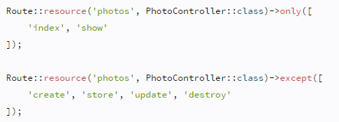
Pemrograman Framework
Resource Controllers
When declaring a resource route, you may specify a subset of actions the controller should handle instead of the full set of default actions (Partial Resource Routes).

Slide 13
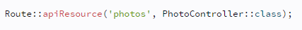
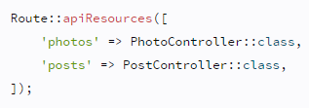
Pemrograman Framework
Resource Controllers
When declaring resource routes that will be consumed by APIs, you will commonly want to exclude routes that present HTML templates such as create and edit. For convenience, you may use the apiResource method to automatically exclude these two routes.
You may register many API resource controllers at once by passing an array to the apiResources method.
To quickly generate an API resource controller that does not include the create or edit methods, use the --api switch when executing the make:controller command.

Slide 14
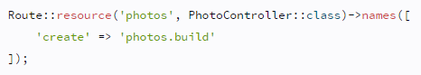
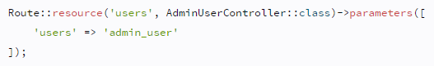
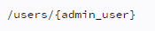
Pemrograman Framework
Resource Controllers
By default, all resource controller actions have a route name, however, you can override these names by passing a names array with your options.
By default, Route::resource will create the route parameters for your resource routes based on the "singularized" version of the resource name. You can easily override this on a per resource basis by using the parameters method. The array passed into the parameters method should be an associative array of resource names and parameter names.
The example above generates the following URIs for the resource's show route.

Slide 15
LIVE CODING SESSION
Let’s Code!

Slide 16
Pengenalan View

Slide 17
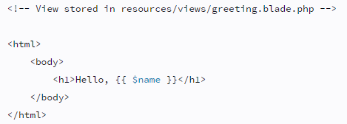
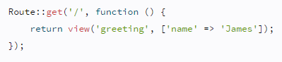
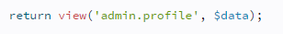
Pemrograman Framework
Creating Views
Views contain the HTML served by your application and separate your controller / application logic from your presentation logic. Views are stored in the resources/views directory. A simple view might look something like this.
Since this view is stored at resources/views/greeting.blade.php, we may return it using the global view helper like so.
Views may also be nested within subdirectories of the resources/views directory. "Dot" notation may be used to reference nested views. For example, if your view is stored at resources/views/admin/profile.blade.php, you may reference it like so.

Slide 18
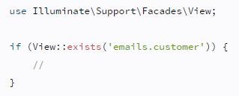
Pemrograman Framework
Determining If a View Exists
If you need to determine if a view exists, you may use the View facade.
The exists method will return true if the view exists.

Slide 19
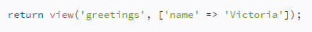
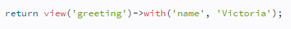
Pemrograman Framework
Passing Data to Views
As you saw in the previous examples, you may pass an array of data to views:
When passing information in this manner, the data should be an array with key / value pairs.
Inside your view, you can then access each value using its corresponding key, such as <?php echo $key; ?>.
As an alternative to passing a complete array of data to the view helper function, you may use the with method to add individual pieces of data to the view.

Slide 20
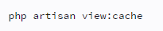
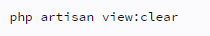
Pemrograman Framework
Optimizing Views
By default, views are compiled on demand. When a request is executed that renders a view, Laravel will determine if a compiled version of the view exists.
If the file exists, Laravel will then determine if the uncompiled view has been modified more recently than the compiled view. If the compiled view either does not exist, or the uncompiled view has been modified, Laravel will recompile the view.
Compiling views during the request negatively impacts performance, so Laravel provides the view:cache Artisan command to precompile all of the views utilized by your application. For increased performance, you may wish to run this command as part of your deployment process.
You may use the view:clear command to clear the view cache.

Slide 21
LIVE CODING SESSION
Let’s Code!

Slide 22
CSRF (Cross Site Request Forgery)

Slide 23
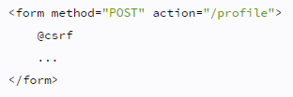
Pemrograman Framework
CSRF Protection
Laravel makes it easy to protect your application from cross-site request forgery (CSRF) attacks. Cross-site request forgeries are a type of malicious exploit whereby unauthorized commands are performed on behalf of an authenticated user.
Laravel automatically generates a CSRF "token" for each active user session managed by the application. This token is used to verify that the authenticated user is the one actually making the requests to the application.
Anytime you define an HTML form in your application, you should include a hidden CSRF token field in the form so that the CSRF protection middleware can validate the request. You may use the @csrf Blade directive to generate the token field:

Slide 24
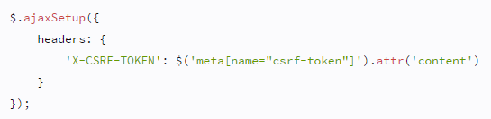
Pemrograman Framework
X-CSRF-TOKEN
In addition to checking for the CSRF token as a POST parameter, the VerifyCsrfToken middleware will also check for the X-CSRF-TOKEN request header. You could, for example, store the token in an HTML meta tag.
Then, once you have created the meta tag, you can instruct a library like jQuery to automatically add the token to all request headers. This provides simple, convenient CSRF protection for your AJAX based applications.

Slide 25
Form Validation

Slide 26
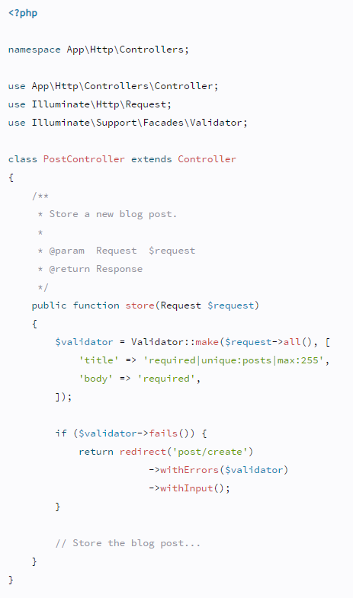
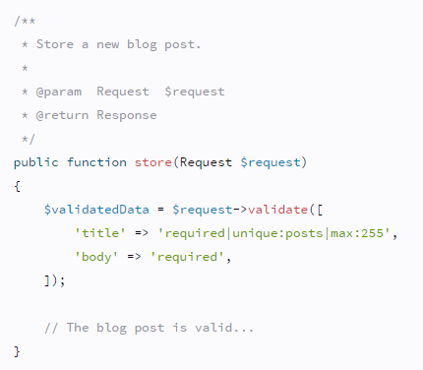
Pemrograman Framework
Validation
Laravel provides several different approaches to validate your application's incoming data.
By default, Laravel's base controller class uses a ValidatesRequests trait which provides a convenient method to validate incoming HTTP requests with a variety of powerful validation rules.

Slide 27
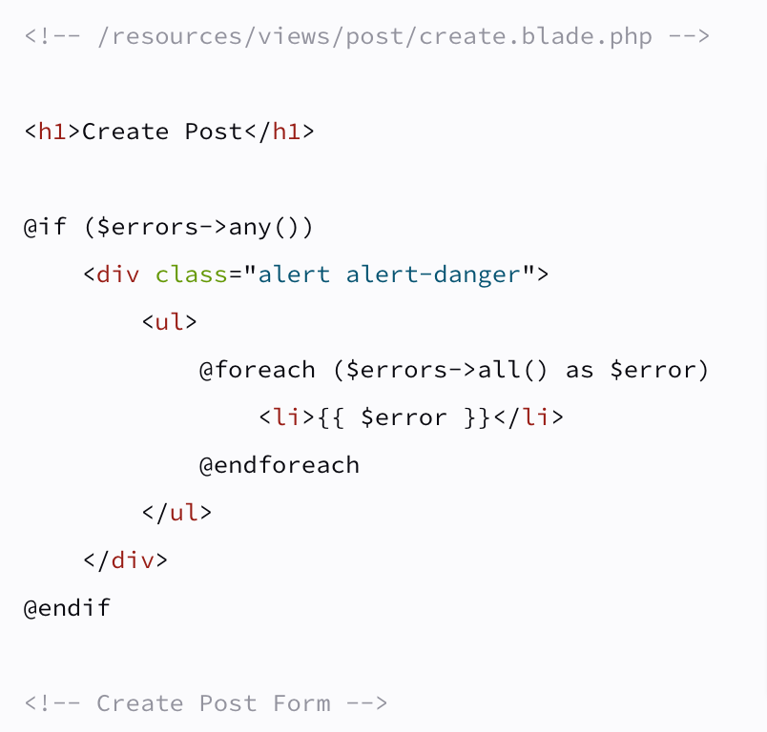
Pemrograman Framework
Displaying The Validation Errors
Laravel will automatically redirect the user back to their previous location. In addition, all of the validation errors and request input will automatically be flashed to the session.
An $errors variable is shared with all of your application's views by the Illuminate\View\Middleware\ShareErrorsFromSession middleware, which is provided by the web middleware group.

Slide 28
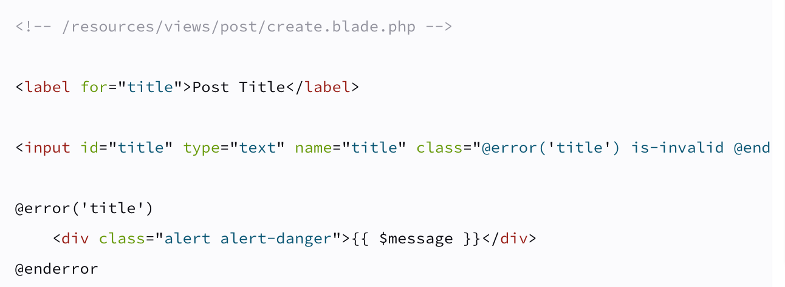
Pemrograman Framework
Displaying The Validation Errors
You may use the @error Blade directive to quickly determine if validation error messages exist for a given attribute. Within an @error directive, you may echo the $message variable to display the error message.

Slide 29
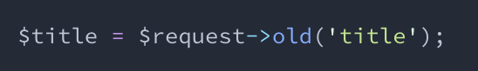
Pemrograman Framework
Repopulating Forms
When Laravel generates a redirect response due to a validation error, the framework will automatically flash all of the request's input to the session. This is done so that you may conveniently access the input during the next request and repopulate the form that the user attempted to submit.
To retrieve flashed input from the previous request, invoke the old() method on an instance of Illuminate\Http\Request. The old() method will pull the previously flashed input data from the session.
Laravel also provides a global old() helper. If you are displaying old input within a Blade template, it is more convenient to use the old() helper to repopulate the form. If no old input exists for the given field, null will be returned.

Slide 30
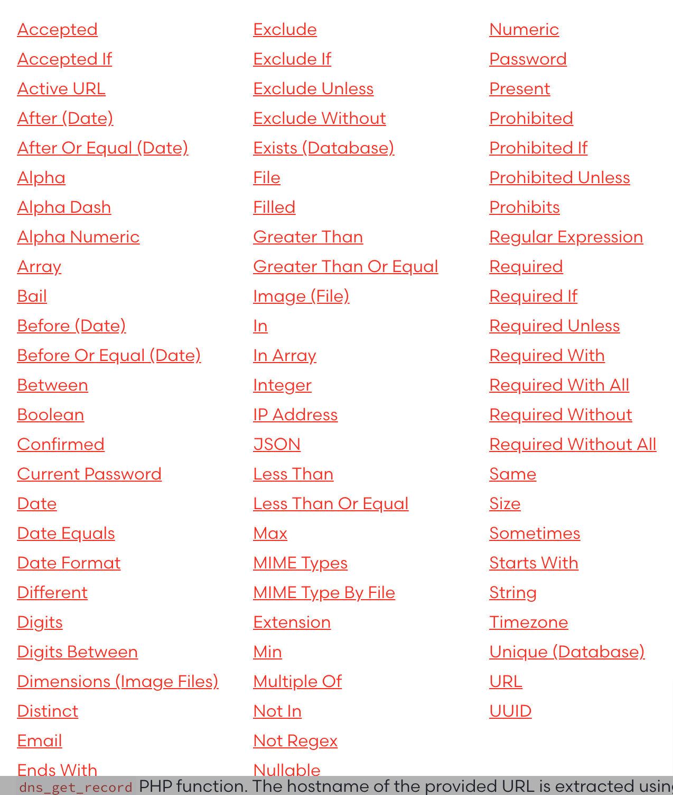
Pemrograman Framework
Available Validation Rules
List of all available validation rules and their function.
https://laravel.com/docs/8.x/validation#available-validation-rules

Slide 31
Any Questions?

Slide 32
Pemrograman Framework
Doa Memohon Kemudahan
Dari Anas bin Malik, beliau berkata bahwa Nabi shallallahu ‘alaihi wa sallam bersabda,
اللَّهُمَّ لاَ سَهْلَ إِلاَّ مَا جَعَلْتَهُ سَهْلاً وَأَنْتَ تَجْعَلُ الحَزْنَ إِذَا شِئْتَ سَهْلاً
“Allahumma laa sahla illa maa ja’altahu sahlaa, wa anta taj’alul hazna idza syi’ta sahlaa” [artinya: Ya Allah, tidak ada kemudahan kecuali yang Engkau buat mudah. Dan engkau menjadikan kesedihan (kesulitan), jika Engkau kehendaki pasti akan menjadi mudah].
Hadits ini dikeluarkan oleh Ibnu Hibban dalam Shahihnya (3/255). Dikeluarkan pula oleh Ibnu Abi ‘Umar, Ibnus Suni dalam ‘Amal Yaum wal Lailah. (Lihat Jaami’ul Ahadits, 6/257, Asy Syamilah)
Sumber: https://rumaysho.com/1182-doa-memohon-kemudahan.html
Semoga Allah mudahkan proses belajar anda semua.

